Slide 1


Chapter 4
Vector geometry

Slide 2
Chapter Outline
4.1. Vectors
4.2. Dot product
4.3. Orthogonality
4.4. Lines.
4.5. Planes
4.6. The Cross Product.

Slide 3
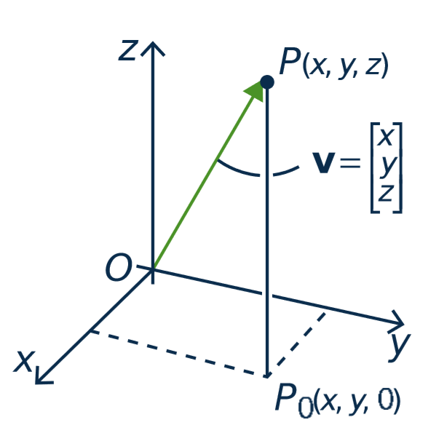
4.1. Vectors
Vectors in ○³
The terms vector and point are interchangeable.
point P(x, y, z)
vector v

Slide 4
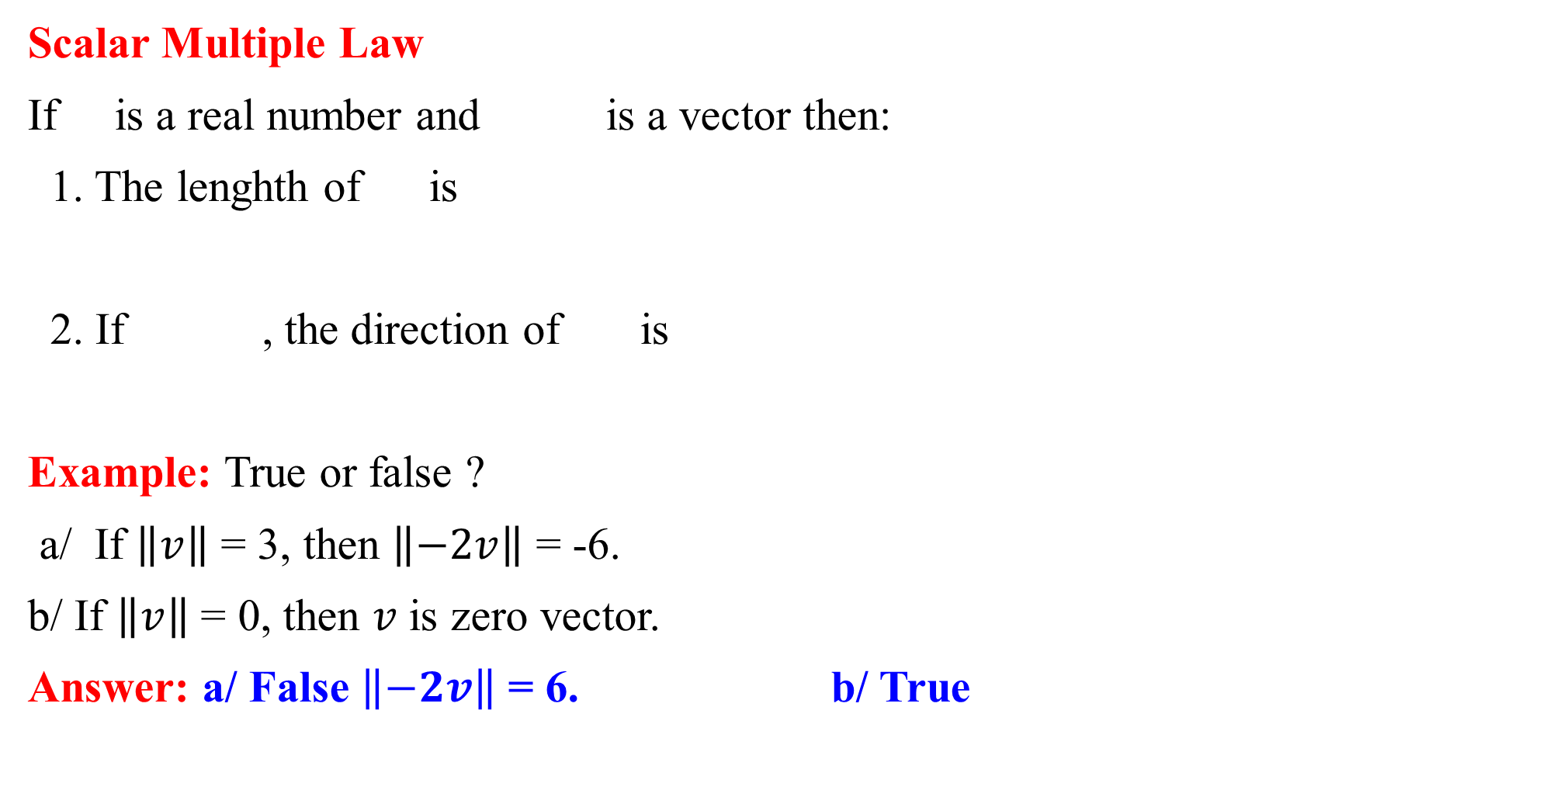
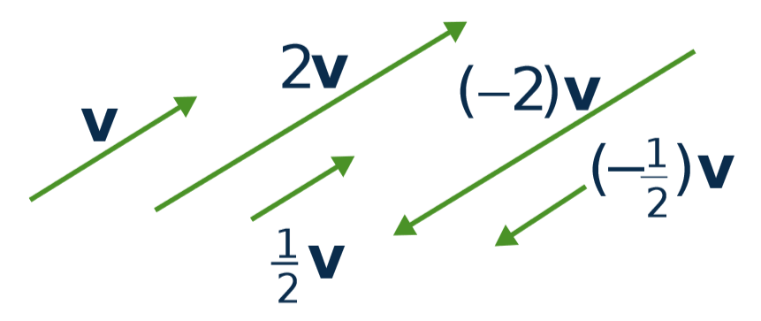



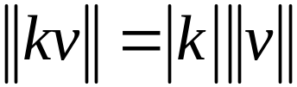
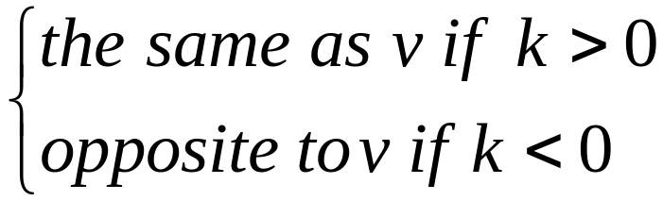

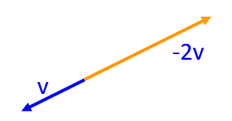
4.1. Vectors

Slide 5
4.1. Vectors
Equality
Let v ≠ 0 and w ≠ 0 be vectors in R³.
Then v = w if and only if v and w have the same direction and the same length.
Note: The same geometric vector can be positioned anywhere in space.
•
•
v
w
•
•

Slide 6
4.1. Vectors
Parallel vectors
Two nonzero vectors are called parallel if they have the same or opposite direction.
v and w are parallel ⇔ v = kw for some scalar k.
v
-2v

Slide 7
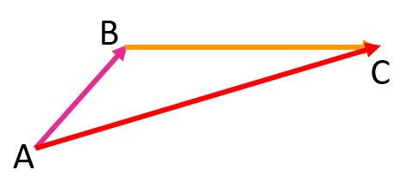
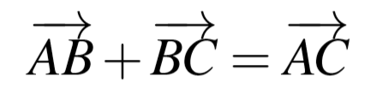
4.1. Vectors
The Parallelogram Law
Tip-to-tail rule
v
v + w ⬅ first v then w
v + w = w + v
w

Slide 8
4.2. Dot product
Definition:
If X= [x₁ x₂ … x_{m}]^{T}, Y= [y₁ y₂ … y_{m}]^{T}
We define X•Y=x₁y₁+x₂y₂+…+x_{m}y_{m}

Slide 9
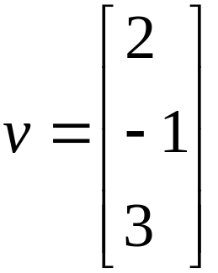
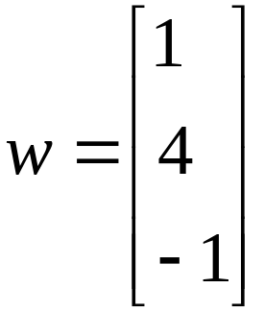

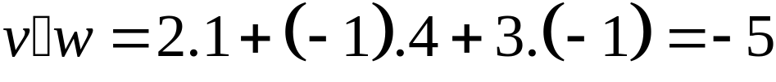
4.2. Dot product
Example:
If and , evaluate
Solution:

Slide 10




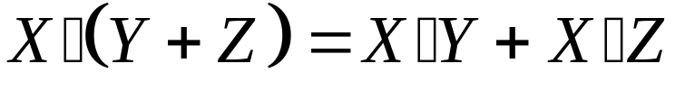
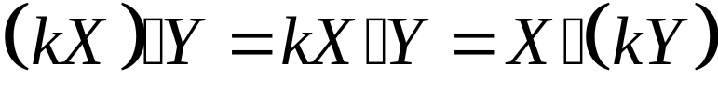
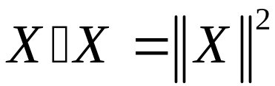
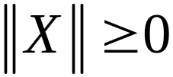

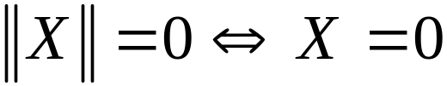
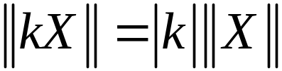
4.2. Dot product
Theorem:
Let and denote vectors in . Then:
1/
2/
3/ for all scalar
4/
5/ for all vector .
6/ for all

Slide 11
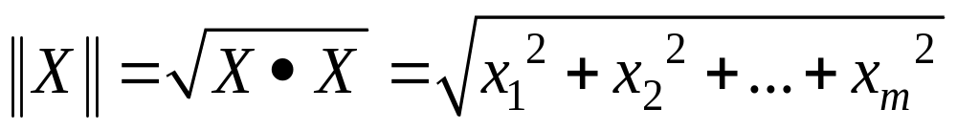
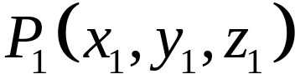
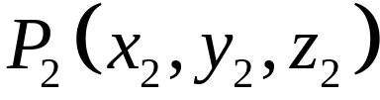
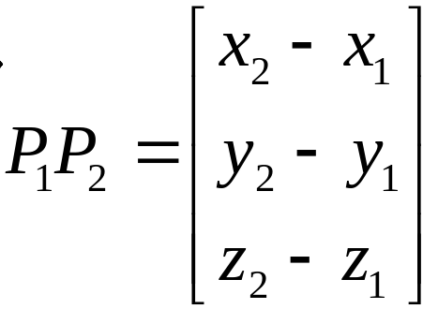
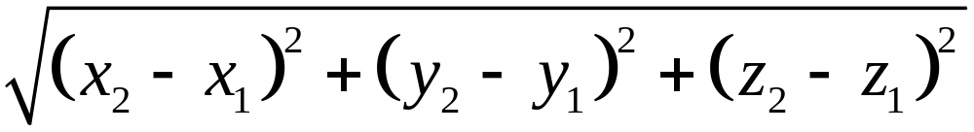


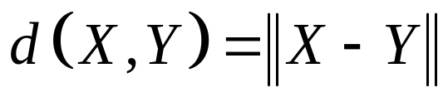
4.2. Dot product
Length and distance
a/ The length of a vector:
If X=[x₁ x₂ … x_{m}]^{T} then
A vector with length 1 is called a unit vector.
b/ Distance between two points: Let and . Then:
  1.
2. The distance between and is
c/ Distance between X and Y defined by

Slide 12

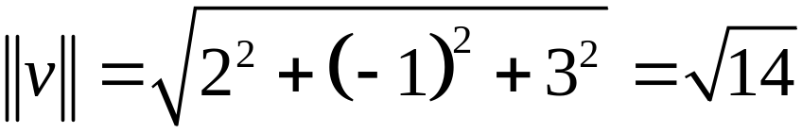
4.2. Dot product
Example 1:
Find , if
Solution:

Slide 13
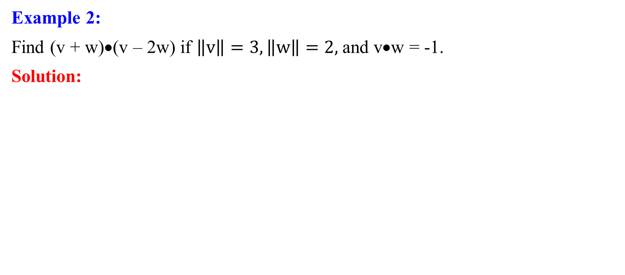
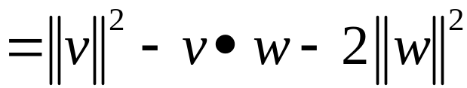
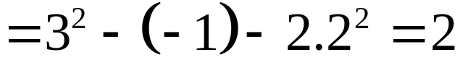
4.2. Dot product

Slide 14
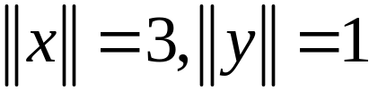

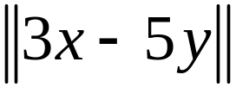
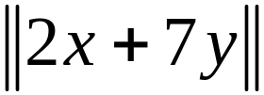
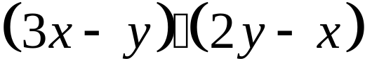
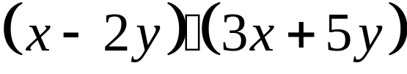
4.2. Dot product
Example 3:
If and . Compute:
a/ b/
c/ d/

Slide 15

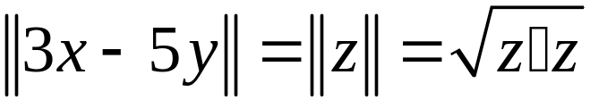
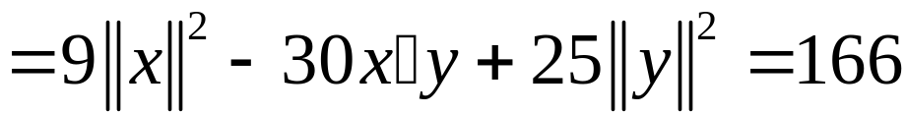
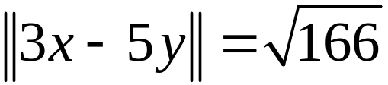
4.2. Dot product
Solution:
a/
Set . We have
So,

Slide 16
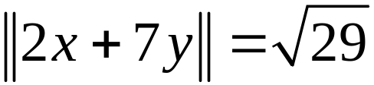
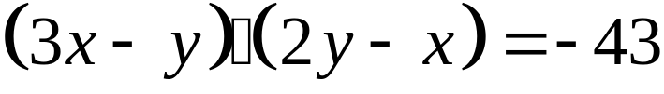
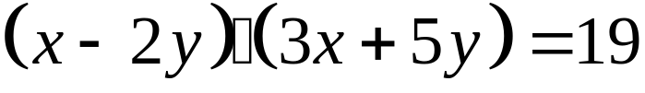
4.2. Dot product
Solution:
b/
c/
d/

Slide 17


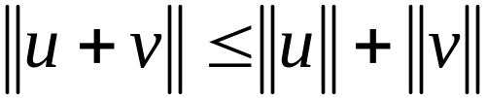

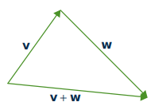
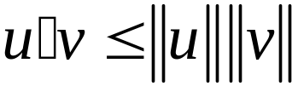
4.2. Dot product
Theorem 1 (Corollary triangle Inequality)
If and ares vectors in , then
Theorem 2 (Cauchy Inequality)

Slide 18
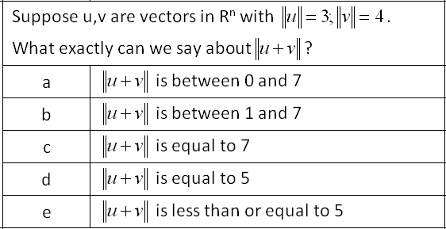
Example:
4.2. Dot product

Slide 19
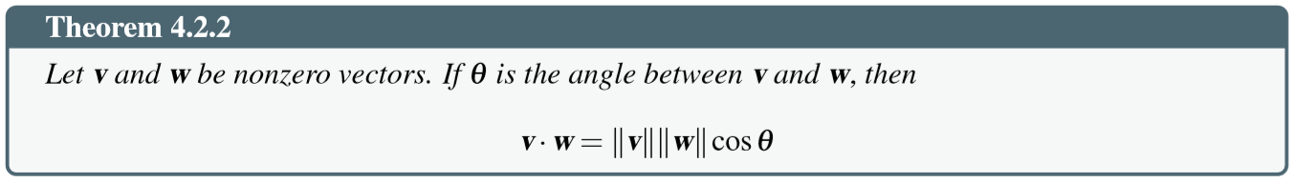
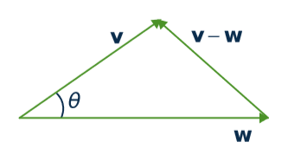
Angles between vectors
4.2. Dot product

Slide 20
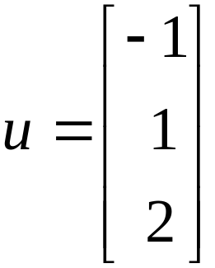
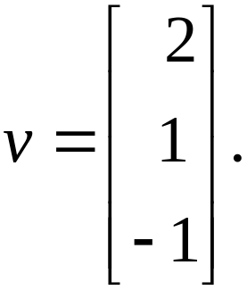
4.2. Dot product
Example 1:
Compute the angle between and

Slide 21
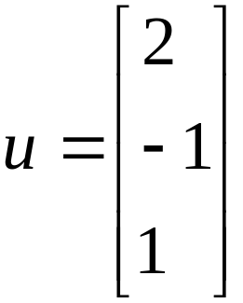
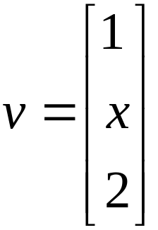


4.2. Dot product
Example 2:
Find all real numbers such that and are at an angle of

Slide 22
4.3. Orthogonality
Definition 1:
Two vectors v and w are said to be orthogonal if v • w = 0.

Slide 23
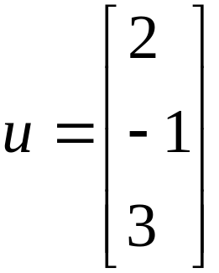
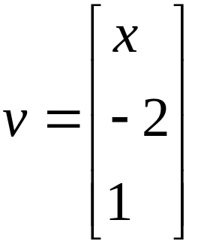
4.3. Orthogonality
Example 1:
Find all real numbers such that and are orthogonal.

Slide 24


4.3. Orthogonality
Example 2:
Show that the points and are the vertices of a
right triangle.

Slide 25








4.3. Orthogonality
Solution:
The vectors along the sides of the triangle are
and
Evidently , so and are orthogonal vectors.
This means sides and are perpendicular, that is, triangle at is a right angle.

Slide 26
4.3. Orthogonality
Definition 2:
A set {x₁,x₂,…,x_{m}} is called orthogonal set if x_{i} is not zero vector and x_{i}•x_{j}=0 for all i≠j.
Example:
a/ S = {(1,-1);(1,1)} is an orthogonal set in R²
b/ E = {(1,1,1);(-1,0,1);(0,1,0)} is not orthogonal set but {(-1,0,1);(0,1,0)} is a orthogonal set

Slide 27

4.3. Orthogonality
Definition 3:
A orthogonal set {x₁,x₂,…,x_{m}} is called orthonormal set (hệ trực chuẩn) is x_{i} is
unit vector for all i.

Slide 28

4.3. Orthogonality
Example:
a/ S = {(1,0,0);(0,1,0)} is orthonormal
b/ B = {(-3,0,4);(4,5,3)} is a orthogonal set, not a orthonormal set. However, the set
is orthonormal.

Slide 29
Orthonormal Set (hệ trực chuẩn)
4.3. Orthogonality
Definition:
A set E ={x₁,x₂,…,x_{m}} is called orthonormal basis (cơ sở trực chuẩn) if E is basis and orthonormal set.

Slide 30
4.3. Orthogonality
Theorem:
The standard basis of R^{n} {E₁,E₂,…,E_{n}} is orthonormal.
If {F₁,F₂,…,F_{k}} is orthogonal then {a₁F₁,a₂F₂,…,a_{k}F_{k}} is also orthogonal for any nonzero scalar a_{i}
Every orthogonal set is a linearly independent set.

Slide 31

4.3. Orthogonality
Pythagoras’s Theorem
If {F₁,F₂,…,F_{k}} is orthogonal then

Slide 32

4.3. Orthogonality
Expansion Theorem
Let {F₁,F₂,…,F_{k}} be a orthogonal basis of a subspace U and X is in U. Then
Notes:
3, 4, 5,6 p. 252

Slide 33

4.3. Orthogonality
Example:
In each case, write as a linear combination of the orthogonal basis of the subspace
a/
b/
Notes:
3, 4, 5,6 p. 252

Slide 34




4.3. Orthogonality
Solution:
a/
Set
So,
Notes:
3, 4, 5,6 p. 252

Slide 35

4.3. Orthogonality
Solution:
b/
Answer:

Slide 36





4.4. Lines
Lines in Space:
Given the point and the direction vector
Then line parallel to d through the point P₀ is given by:
P = P₀ + td, (t is any number) or
In other words, the point is on this line if and only if a real number exists such that

Slide 37
4.4. Lines
Example:
In each case, find a vector equation of the line,
a/ Passing through P(3,-1,4) and perpendicular to the plane 3x - 2y - z = 0.
b/ Passing through P(2,-1,3) and perpendicular to the plane 2x + y = 1.

Slide 38




4.4. Lines
Projection
Theorem
Let and be vectors
1. The projection of on is given by
2. The vector is orthogonal to
1. v ⁄ d
2. u – v ⊥ d

Slide 39





4.4. Lines
Example 1:
Find the projection of on and express where
is parallel to and is orthogonal to .

Slide 40


4.4. Lines
Solution:
The projection of on is
Hence

Slide 41



4.4. Lines
Example 2:
In each case, compute the projection of on
a/ b/ c/

Slide 42


4.4. Lines
Example 3:
In each case, write , where is parallel to and is orthogonal to
a/ b/

Slide 43




4.5. Planes
.

Slide 44



4.5. Planes
Example 1:
Find an equation of the plane through with as normal.
Solution:
Equation of the plane is

Slide 45





4.5. Planes
Example 2:
In each case, find all points of intersection of the given plane and line
a/ b/
c/ d/

Slide 46





4.6. The Cross Product
Definition:
Given vectors and , define the cross product by

Slide 47





4.6. The Cross Product
Theorem 1:
Let and be vectors in
1. is a vector orthogonal to both and
2. If and are nonzero, then if and only if and are parallel.

Slide 48








4.6. The Cross Product
Example 1:
Find an equation of each of the following planes
a/ Passing through and
b/ Passing through and
c/ Passing through and parallel to the plane with equation
d/ Passing through and parallel to the plane with equation

Slide 49






4.6. The Cross Product
Example 2:
Find the equation of the plane through and
Solution:
The vectors and lie in plane, so
Hence, the plane has equation

Slide 50



4.6. The Cross Product
Theorem 2:
If and are two nonzero vectors and is the angle between and , then
area of the parallelogram determined by and

Slide 51



4.6. The Cross Product
Example:
Find the area of the triangle with vertices and .
Answer:

Slide 52



4.6. The Cross Product
Theorem 3:
If , and , then

Slide 53



4.6. The Cross Product
Theorem 4:
The volume of the parallelepiped determined by three vectors and is
given by

Slide 54

4.6. The Cross Product
Example:
Find the volume of the parallelepiped determined by the vectors
Answer: 3

